Slide 1
Week 1
Session 1
Entrepreneurship and Small Business Management

Slide 2
WHAT is ENTREPRENEURSHIP?•
Entrepreneurship – • Accepting the risk of starting and running a
business.

Slide 3
Who is an entrepreneur?
Why entrepreneurship?
Process of creating something different, with value, by devoting necessary time and effort, by assuming the accompanying financial, psychological, and social risks, and receiving the resulting rewards of monetary and personal satisfaction (Bowen and H isrich, 1986).
Person conducting own business (Webster).
Person who sets up business deals in order to make profits (Collins
Cobuild)
• Organizer of an economic venture, one who owns, organizes,
manages, and assumes the risks of the business (Chandrashekhar)

Slide 4
Role of the Entrepreneur
•An innovator who combines technical innovations and
financial finesses. Important role in producing
competitive products, processes, and services.
Generation of new employment Local and regional
economic development Improved allocation of
resources and transfer of technologies

Slide 5
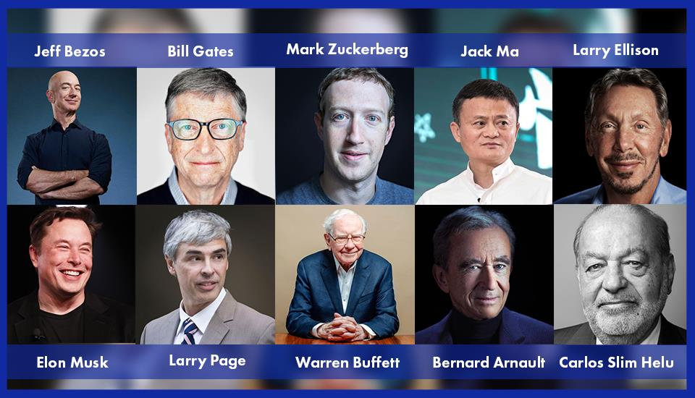

Slide 6
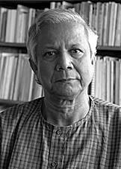
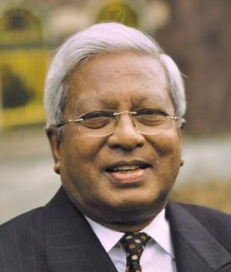
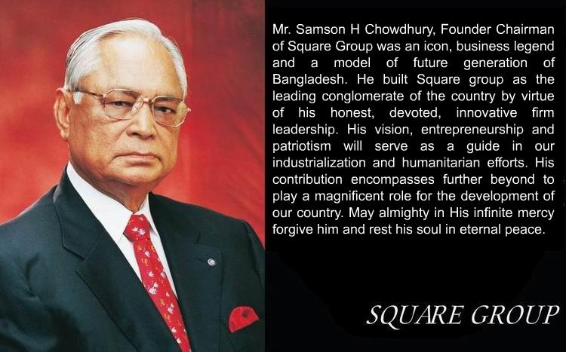
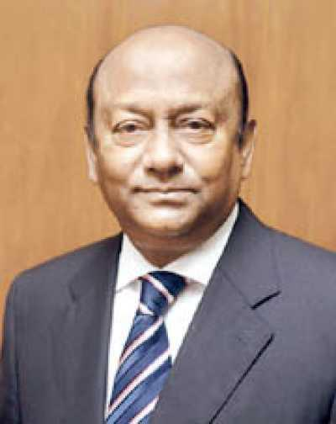
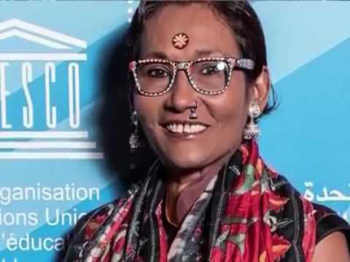
Famous Entrepreneurs – Bangladesh
Muhammad Yunus
Fazle Hasan Abed
Latifur Rahman
Bibi Russell

Slide 7
YOU’RE NEVER TOO YOUNG to be an
ENTREPRENEUR (Spotlight on Small Business)
Leanna Archer – At 12 years old, she has her own hair care line.
• Alexis Holmes – Started baking for a fundraiser, now the 16-year-old
owns her own bakery.
• Jack Short & Daniel Lyons – The two medical students started Factory
Green, a carbon neutral apparel company, as undergrads.
• Mark Zuckerberg – Launched Facebook as a Harvard freshman.

Slide 8
Entrepreneur- the individual that is a risk taker and innovator
• Entrepreneurship- the business that is creative and
risky.
Characteristics: Creative, confident, goal-oriented, motivated, hard-working.
• Risks: Unproven idea, little management experience,
long-hours with no guarantee of a profit

Slide 9
Entrepreneurship VS Working for others
Entrepreneurship
• Own the business
• Freedom to succeed as well as freedom to fail
• Do not receive any benefits such as paid vacation time, day care, a company car or health insurance.
Working for others
• Somebody else assumes entrepreneurial risk
• Provides with benefits such as paid vacation and health
insurance.

Slide 10
• What are the sources of financing that entrepreneurs use for their new businesses?
• Personal savings
• Friends and family
• Venture capital
• Bank loans

Slide 11
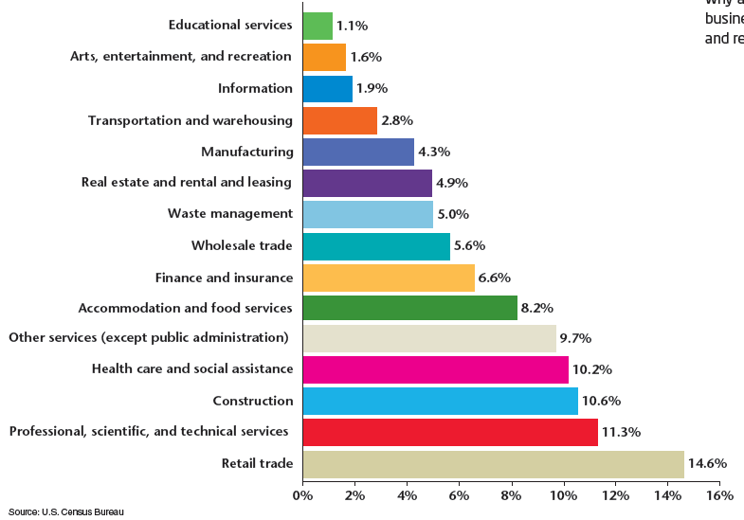
Common Types of Small Businesses as Percent of All Small Businesses

Slide 12
What Is a Business Plan?
A business plan is a written document that describes in detail how a business usually a startup—
defines its objectives and how it is to go about achieving its goals. A business plan lays out a written roadmap for the firm from marketing, financial, and operational standpoints.
5 ELEMENTS
1)Description of the business & goals
2)Customer Analysis- knowing your customer
3)Operations Plan- organizing the business
4)Marketing Plan- marketing & advertising
5)Financial Plan- Creating a Budget: ( Start-up, Short and Long-term Financing)

Slide 13
FORMS of BUSINESS OWNERSHIP
SOLE PROPRIETORSHIP
PARTNERSHIPS
CORPORATIONS

Slide 14
BENEFITS of SOLE PROPRIETORSHIP
DISADVANTAGES of SOLE PROPRIETORSHIPS
Unlimited Liability -- Any debts or damages incurred by the business are your debts, even if it means selling your home, car or anything else.
• Limited financial resources
• Management difficulties
• Overwhelming time commitment
• Ease of starting and ending the business
• Being your own boss
• Pride of ownership
• Leaving a legacy
• Retention of company profit
• No special taxes

Slide 15
Major Types of Partnerships
• General Partnership - - All owners share in operating the business and in assuming liability for the business’s debts.
• Limited Partnership - - A partnership with one or more
general partners and one or more limited partners.

Slide 16
ADVANTAGES of PARTNERSHIPS
DISADVANTAGES of PARTNERSHIPS
• Unlimited liability
• Division of profits
• Difficult to terminate
• Disagreements among partners
• More financial resources
• Shared management and pooled skills and knowledge
• Longer survival
• No special taxes

Slide 17
CONVENTIONAL CORPORATIONS
• Conventional (C) Corporation -- A state-chartered legal entity with authority to act and have liability separate from its owners
(its stockholders).
Most Bangladeshi companies are registered as private limited liability companies, commonly known as private limited companies. A private limited company in Bangladesh is a separate legal entity and shareholders are not liable for the company’s debts beyond the amount of share capital they have contributed. According to the Companies Act 1994, any person (foreign or local) above the age of 18 can register a company in Bangladesh.
Limited Companies are two types one is
(a) Private Limited Company and another is (b) Public Limited Company.

Slide 18
To form Private Limited Company minimum two and maximum fifty directors required.
• On the other hand, for Public Limited Company minimum member should be seven and the maximum is unlimited.
For forming a Joint Venture Company minimum member should be two and maximum fifty. Out of all members minimum, one should be Bangladeshi and minimum one should be Foreigner. In
Bangladesh no scope to start a Limited Company by one man.

Slide 19
Corporation Advantages
Disadvantages of Corporations
Initial cost
Extensive paperwork
Double taxation
Difficulty of termination
Conflict with Stockholders and Board
Size
Limited liability
More money for Investment
Size
Perpetual life.
Ease of ownership change
Ease of attracting talented employee.
Separation of ownership from management.

